Slide 1
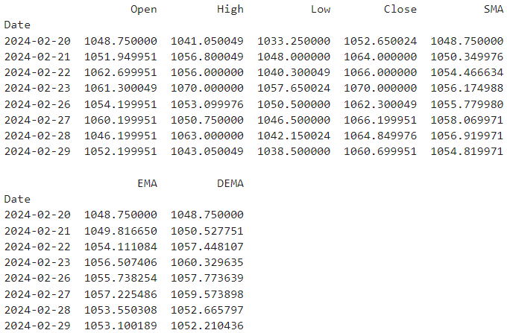

Slide 2
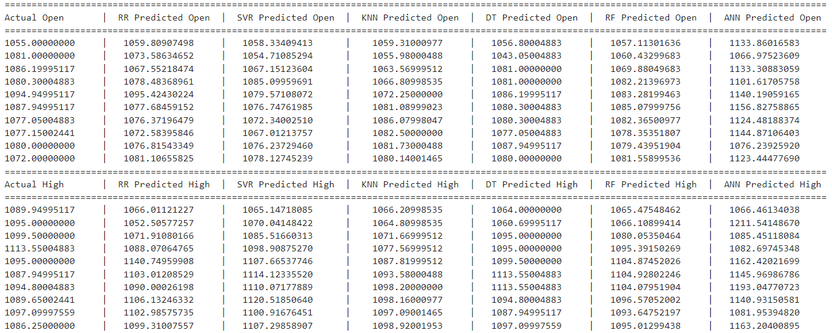
COMPARED ACTUAL AND PREDICTED PRICES
OPEN
HIGH

Slide 3
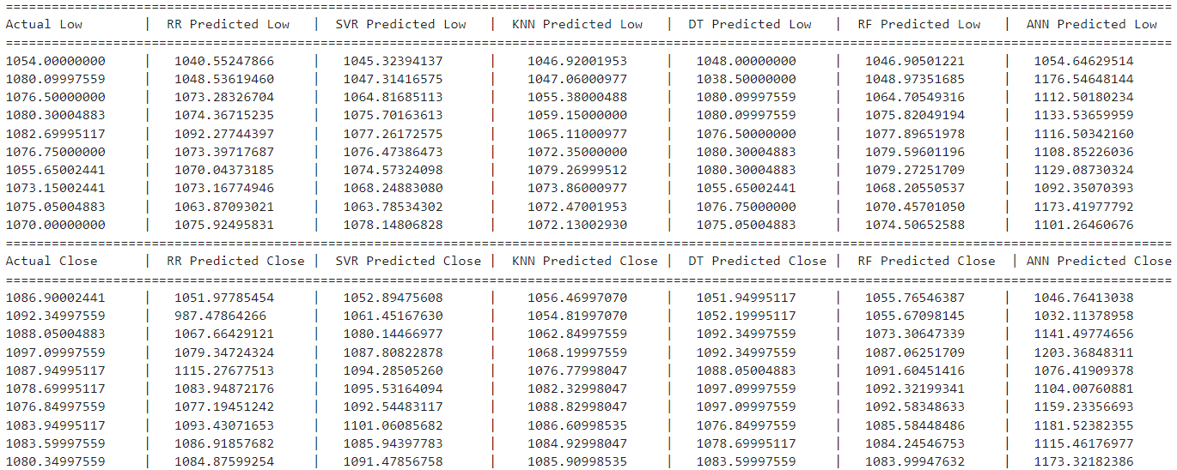
COMPARED ACTUAL AND PREDICTED PRICES
LOW
CLOSE

Slide 4
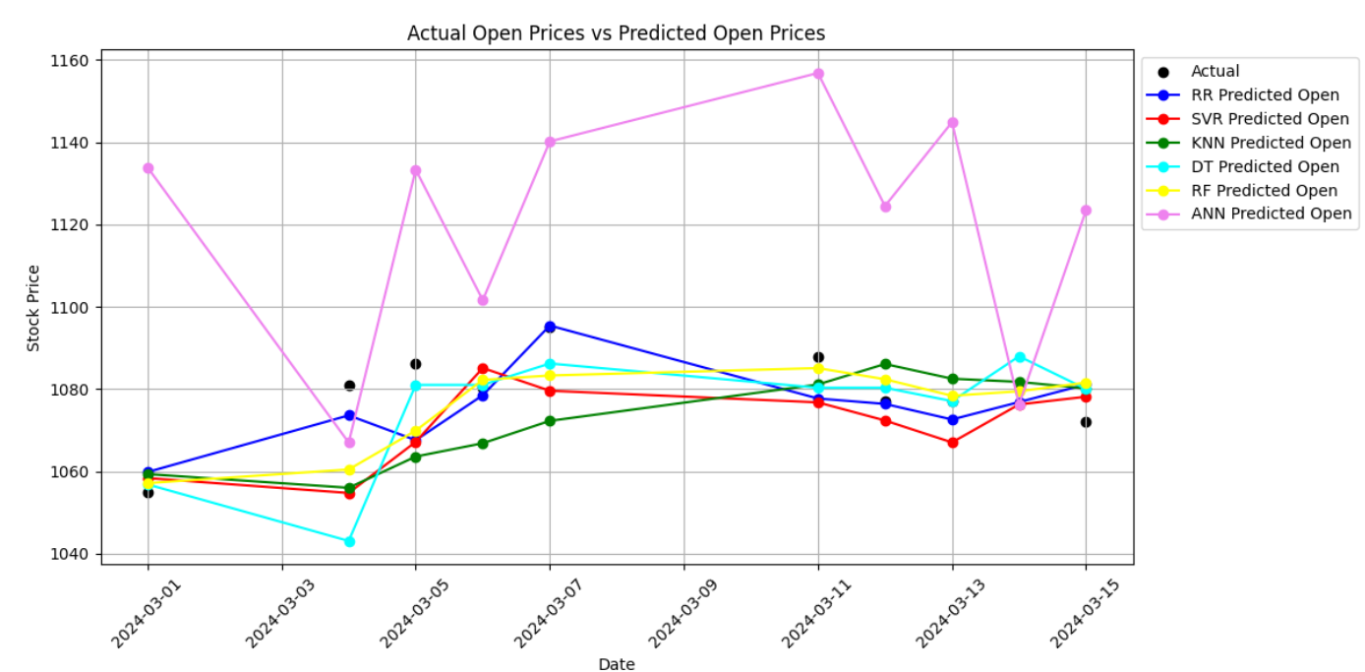
OPEN PRICES

Slide 5
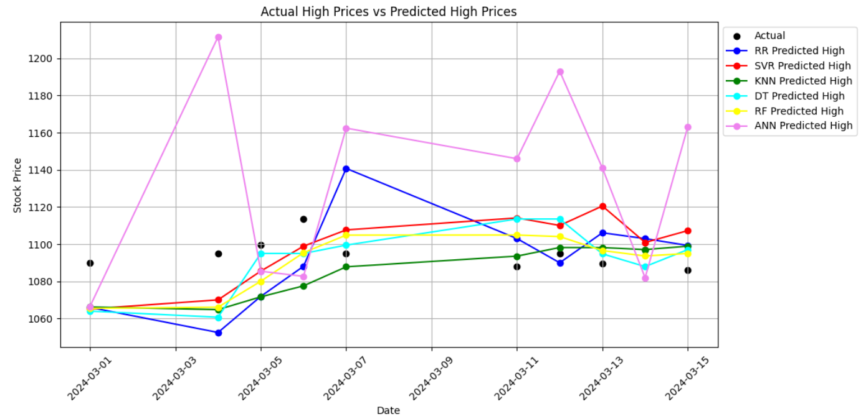
HIGH PRICES

Slide 6
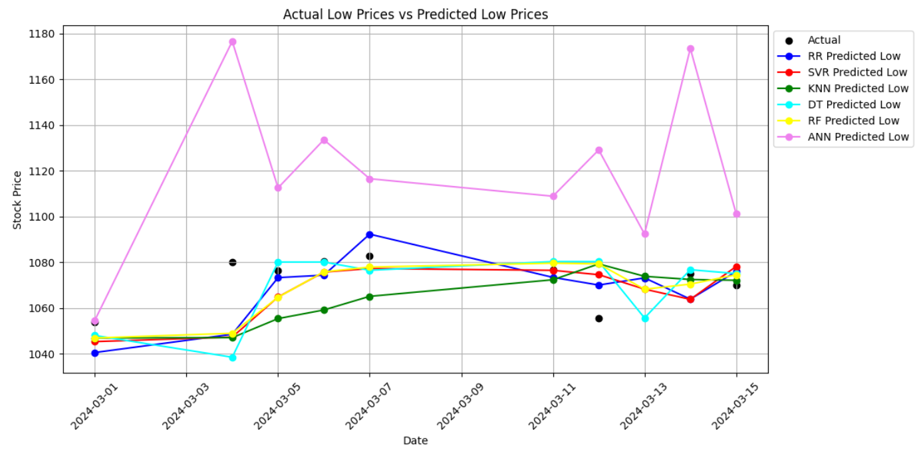
LOW PRICES

Slide 7
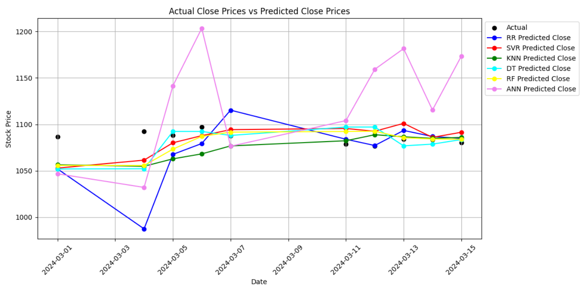
CLOSE PRICE

